Slide 1
ANALYTICAL MODELLING
PROCESS MODELLING

Slide 2
Classification of Process Models
Process model simulates real-world processes.
It is a relatively simple task to classify process models into one of two types: a priori or a posteriori.
A priori models are used to model processes for which a body of theory has yet to be established.
Scientists involved in research to establish whether global warming is taking place would perhaps use a priori models, as the phenomenon of global warming is still under investigation.

Slide 3
Classification of Process Models
A posteriori models, on the other hand, are designed to explore an established theory. These models are usually constructed when attempting to apply theory to new areas.
An a posteriori model might be developed to help predict avalanches in a mountain area where a new ski piste has been proposed.

Slide 4
Natural and scale analogue models
A natural analogue model uses actual events or real world objects as a basis for model construction.
These events or objects occur either in different places or at different times.
A natural analogue model to predict the formation of avalanches in the previously unstudied area of a new ski piste might be constructed by observing how avalanches form in an area of similar character.

Slide 5
Scale Analogue & Conceptual Model
Scale analogue models such as topographic maps and aerial photographs, which are scaled down and generalized replicas of reality.
These are exactly the kind of analogue models that GIS might use to model the avalanche prediction problem.
Conceptual process models are usually expressed in verbal or graphical form, and attempt to describe in words or pictures quantitative and qualitative interactions between real-world features.

Slide 6
Mathematical models
Mathematical process models use a range of techniques including deterministic, stochastic and optimization methods.
In deterministic models, there is only one possible answer for a given set of inputs.
Stochastic models recognize that there could be a range of possible outcomes for a given set of inputs, and express the likelihood of each one happening as a probability.
Optimization models are constructed to maximize or minimize some aspect of the model’s output.

Slide 7
MODELLING PHYSICAL AND
ENVIRONMENTAL PROCESSES
In a spatial context, perhaps one of the most challenging tasks for physical and environmental modellers is forecasting what may happen in the future under a given set of conditions.
For example, predicting when and where a flood may occur or where an avalanche may take place is a difficult task.
However, if the nature of the system under investigation is reasonably well understood then it can be modelled and future trends, conditions, changes and outcomes forecast.

Slide 8
MODELLING PHYSICAL AND
ENVIRONMENTAL PROCESSES
Forecasting is inherently time-dependent. Unfortunately GIS data models handle the time dimension poorly.
Therefore, most applications that involve making predictions or forecasts are based around some non-GIS model. Often these models are not spatial (aspatial).
These models are linked with GIS they can be expanded to include a range of spatial inputs and outputs.

Slide 9
MODELLING PHYSICAL AND
ENVIRONMENTAL PROCESSES
Linking existing aspatial models with GIS can be difficult because the models do not necessarily include important key spatial phenomena such as spatial interaction and spatial autocorrelation when making their predictions.
Other models are inherently spatial and are particularly well suited for integration with GIS. The linking of existing forecasting models with GIS provides access to a larger database and tools to visualize how a spatial phenomenon diffuses over time.

Slide 10
MODELLING PHYSICAL AND
ENVIRONMENTAL PROCESSES
Forecasting models tend to be dynamic, with one or all of the input variables changing over time.
For example, in the case of a forest fire, as time elapses from the start of the fire the prevailing weather conditions will change, as will the amount of forest still left to burn.
Simulating the geographical spread of a dynamic phenomenon such as a forest fire requires a special type of forecasting model known as a diffusion model.

Slide 11
MODELLING PHYSICAL AND
ENVIRONMENTAL PROCESSES
The rate of diffusion of the fire from its starting point is based on the spatial characteristics of the neighbourhood.
The density of trees, the nature of the topography of an area, the presence of previously burnt areas and dynamic variables such as wind direction all affect the spread of fire.
The spatial diffusion problem faced by the fire model is how to use this knowledge to simulate the movement of the fire over time. One way to achieve this is through close coupling with GIS.

Slide 12
MODELLING PHYSICAL AND
ENVIRONMENTAL PROCESSES
One approach to modelling fire behaviour. Their method involved three stages:
A raster approach was used to create a spatial database of the criteria influencing fire behaviour. These criteria were determined from an aspatial model and included data on fuel, topography and weather.
The value associated with each cell in the raster images was then fed into an established aspatial fire modelling program known as BEHAVE. The output was a map showing the status of the fire after a given time.

Slide 13
MODELLING PHYSICAL AND
ENVIRONMENTAL PROCESSES
The modelling capabilities of GIS were then used to ‘spread’ the fire to adjacent cells. The extent of the spread depended on the amount of fuel present, the topography of the land and recent weather. This diffusion process was continued until a specified time limit had been reached or all fuel sources for the fire had been consumed.
Using this approach, the GIS was used to produce three summary maps that showed the rate of spread of the fire, the spatial intensity of the fire and the direction of maximum spread.

Slide 14
MODELLING PHYSICAL AND
ENVIRONMENTAL PROCESSES
A recent development in forecasting models has been to couple GIS with artificial intelligence (AI) techniques such as neural networks.
Neural networks are essentially classification systems that look for pattern and order in complex multivariate data sets. If the data are longitudinal records of inputs and outputs to a system they can be used to ‘train’ a neural network to recognize complex relationships between variables.
The resulting neural network can then be used to predict system outputs from a given set of inputs and knowledge of preceding conditions.

Slide 15
MODELLING PHYSICAL AND
ENVIRONMENTAL PROCESSES
Several problems make accurate forecasting very difficult. It is generally accepted that the accuracy of forecasts decreases with the length of the prediction.
A classic example is the weather forecast. With improved understanding of weather systems and better data, weather forecasters can predict what the weather is going to do in the next 24 to 48 hours fairly accurately.
Beyond 48 hours the accuracy of their predictions begins to fall to such an extent that long-term five-day forecasts are only about 40 percent correct.

Slide 16
MODELLING PHYSICAL AND
ENVIRONMENTAL PROCESSES
The introduction of random or stochastic processes, as advocated by proponents of chaos theory may play an increasingly important role in improving the accuracy of longer-term predictions, especially models of natural systems like weather and climate.

Slide 17
MODELLING HUMAN PROCESSES
Spatial interaction models are used to help understand and predict the location of activities and the movement of materials, people and information.
Spatial interaction models rely on the fact that the nature of this change can be predicted since it can be compared with the behaviour of people elsewhere.
In this respect, spatial interaction models are a form of natural analogue model. Time does not have a role in the simplest spatial interaction models, therefore these models can be implemented in GIS.

Slide 18
MODELLING HUMAN PROCESSES
For example: To predict the flow of people from their home to shops. In this case, the assumption is made that, as long as the number and characteristics of shops and people remain the same, so does the predicted behaviour of people.
It is also assumed that people will use the shops closest to their home. If one parameter in the model is changed (for example, a new shopping centre may be added to increase the choice of shops available) the predicted behaviour of people will change.

Slide 19
MODELLING HUMAN PROCESSES
If the new supermarket is located close to the main apartment complex there is a good chance that a large number of people will make use of the facility.
The amount of trade done by other stores in the area may be reduced as a result. Therefore, the distance between the origin of a journey (the apartment) and the destination (the supermarket) will affect the amount of ‘interaction’ that takes place between the two locations.
If the new supermarket is in a poor location, for example if it is too far away from the main village, the people will continue to use existing stores that are closer.

Slide 20
MODELLING HUMAN PROCESSES
The only way a new supermarket situated away from the apartment blocks may be able to attract customers is to offer additional services and facilities to induce customers to travel further.
The ‘attractiveness’ of a store can be represented in a spatial interaction model as an attractiveness index.

Slide 21
MODELLING HUMAN PROCESSES
The concepts of supply and demand are also important for spatial interaction modelling.
Demand occurs at an origin (for example, the apartment block), while supply is located at destinations (the supermarket).
Production, the capacity of the origin to produce a trip for a particular activity, is also important, and is generally some function of the population of the origin.

Slide 22
MODELLING HUMAN PROCESSES
The concepts of supply and demand are also important for spatial interaction modelling.
Demand occurs at an origin (for example, the apartment block), while supply is located at destinations (the supermarket).
Production, the capacity of the origin to produce a trip for a particular activity, is also important, and is generally some function of the population of the origin.
Distance between an origin and a destination does not have a fixed effect on spatial interaction. The effect of distance depends on the type of activity and customers.

Slide 23
MODELLING HUMAN PROCESSES
The effects of distance and attractiveness can be studied using gravity models. These use a distance-decay function (derived from Newton’s law of gravitation) to compute interactions given the relative attractiveness of different destinations.
The distance-decay function is used to exaggerate the distance between origins and destinations.
The basic data required to develop spatial interaction or gravity models are a set of origins and destinations. These can be provided by a GIS as point entities.

Slide 24
MODELLING HUMAN PROCESSES
In addition, the GIS could be used to provide a further data layer representing the transport networks (including streets and footpaths) along which goods and people move. GIS can be used to calculate real distances between origins and destinations.
In addition, the GIS database can be used to store attribute information about individual locations. In the case of the new supermarket these attributes could include the type of goods and services the store offers.

Slide 25
MODELLING HUMAN PROCESSES
Attributes for the apartments could reflect the socio-economic characteristics of skiers who rent them. This additional information could be used to determine the demand, supply and attractiveness characteristics for the model.
GIS can also be used to display the results of the modelling process as a series of accessibility contours for both origin and destination locations, or as interaction probability surfaces

Slide 26
MODELLING THE DECISION MAKING PROCESS
Outputs from process models of both human and physical systems are the raw information that will be required to assist various types of decision-making.
Output from a location-allocation model might show potential locations for a new supermarket within Happy Valley. This would need to be integrated with other regional planning data to ensure that the resort is being developed in line with regional strategic planning objectives.

Slide 27
MODELLING THE DECISION MAKING PROCESS
Map overlay is the traditional technique for integrating data for use in spatial decision making.
For example, in siting nuclear waste facilities, the criteria defining geological suitability and conservation area status can be combined using the overlay procedures.
Overlay analyses suffer from certain limitations when dealing with decision-making problems of a less well-defined nature.

Slide 28
MODELLING THE DECISION MAKING PROCESS
Digital map overlays are difficult to comprehend when more than four or five factors are involved.
Most overlay procedures in GIS do not allow for the fact that variables may not be equally important.
When mapping variables for overlay analysis, decisions about threshold are important (the outcome of polygon overlay depends strongly on the choice of threshold values).

Slide 29
MODELLING THE DECISION MAKING PROCESS
One way to address these problems is to use multicriteria evaluation (MCE) techniques to either supplement or replace standard map overlay in GIS.
MCE techniques allow map layers to be weighted to reflect their relative importance and, unlike polygon overlay in vector GIS, they do not rely on threshold values.
Therefore, MCE provides a framework for exploring solutions to decision-making problems, which may be poorly defined.

Slide 30
MODELLING THE DECISION MAKING PROCESS
MCE is a method for combining data according to their importance in making a given decision.
At a conceptual level, MCE methods involve qualitative or quantitative weighting, scoring or ranking of criteria to reflect their importance to either a single or a multiple set of objectives.
It is not the intention here to introduce the full range of MCE techniques, since these are documented elsewhere.

Slide 31
MODELLING THE DECISION MAKING PROCESS
MCE techniques are numerical algorithms that define the ‘suitability’ of a particular solution on the basis of the input criteria and weights together with some mathematical or logical means of determining trade-offs when conflicts arise.
It is the overlap with GIS that is of interest, since the application of MCE techniques within a GIS framework permits the limitations of standard map overlay (defined above) to be addressed.

Slide 32
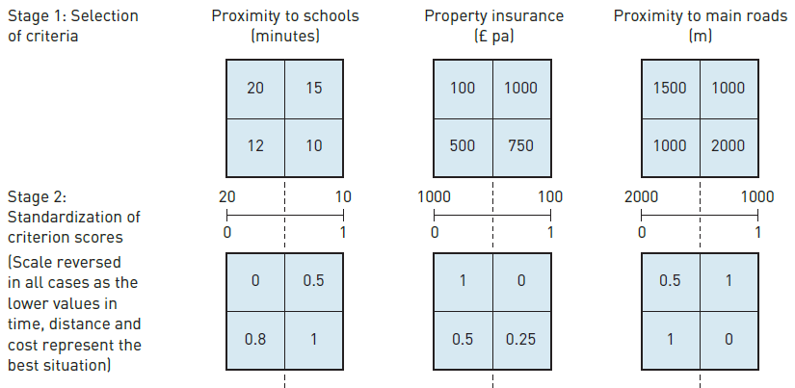
MCE algorithm is the weighted linear summation technique.

Slide 33
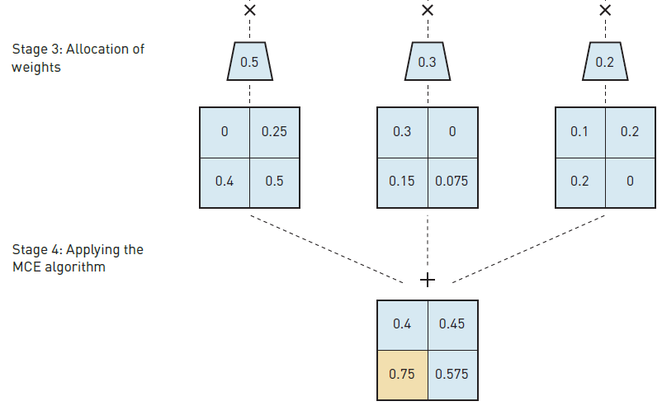
MCE algorithm is the weighted linear summation technique.

Slide 34
MODELLING THE DECISION MAKING PROCESS
GIS is an ideal framework in which to use MCE to model spatial decision-making problems as it provides the data management and display facilities lacking in MCE software.
In return MCE provides GIS with the means of evaluating complex multiple criteria decision problems where conflicting criteria and objectives are present.
Together, GIS and MCE based systems have the potential to provide the decision maker with a more rational, objective and unbiased approach to spatial decision-making and support than hitherto.

Slide 35
PROBLEMS WITH USING GIS TO
MODEL SPATIAL PROCESSES
The use of GIS to facilitate the development of spatial process models is not without problems.
The technical problems can be solved (by integrating or coupling GIS with appropriate software tools), there are other, more conceptual problems that the process modeller wishing to use GIS should be aware of.
These include:
The quality of source data for model calibration;
The availability of data for model validation;
The implementation within a GIS;

Slide 36
PROBLEMS WITH USING GIS TO
MODEL SPATIAL PROCESSES
The complexity of modelling reality; and
The conceptual and technical problems of building multi-dimensional models.
The data requirements of process models can be large and problematic.
For example, many forecast models rely on the availability of longitudinal records to calculate past trends and relationships.
These records are used to predict future conditions. Suitably long records in many cases may not exist.

Slide 37
PROBLEMS WITH USING GIS TO
MODEL SPATIAL PROCESSES
Similarly, models that have been developed in a non-spatial context may require detailed data inputs which, again, do not exist as spatial data sets.
An example of this can be seen in hydrological modelling – where do you obtain detailed spatial data on evapotranspiration rates or soil moisture conditions?
Another example is the Universal Soil Loss Equation, which has often been applied within a GIS context.
The equation is written as:
A = R × K × LS × C × P

Slide 38
PROBLEMS WITH USING GIS TO
MODEL SPATIAL PROCESSES
where: A = average annual soil loss; R = rainfall factor; K = soil erodibility factor; LS = slope length–steepness factor; C = cropping and management factor; and P = conservation practices factor.
Finding the relationship between the factors in the soil loss equation and making the necessary measurements is simple enough for small experimental soil plots.

Slide 39
PROBLEMS WITH USING GIS TO
MODEL SPATIAL PROCESSES
Extending the measurements to a large study area, where the controlling factors can vary by orders of magnitude, is difficult.
Often surrogate measures and interpolated data are used.
For example, spatial variations in evapotranspiration may be estimated by combining previous field studies on different vegetation types and weather with land cover information derived from satellite imagery.

Slide 40
PROBLEMS WITH USING GIS TO
MODEL SPATIAL PROCESSES
All process models need to be validated or checked to make sure that they work and that the results they produce make sense.
The easiest way to validate a model is to compare its predictions with a real event (for example, the predictions of a forest fire model could be compared with a real fire situation.
Starting a fire for model validation would not, however, be a feasible validation method. Equally, if we were trying to model the potential effects of global warming we would have a long time to wait before we could compare the results of our model with reality.

Slide 41
PROBLEMS WITH USING GIS TO
MODEL SPATIAL PROCESSES
However, this approach is unable to solve all problems. In some cases the best option is to produce a range of scenarios showing what the likely outcome may be and hope that reality is somewhere between the worst and best cases.
The main GIS problem associated with validating spatial process models is therefore lack of appropriate spatial data.
Implementation of process models within GIS enforces a spatial context. When models were originally developed for non-spatial applications this can create conceptual and operational problems.

Slide 42
PROBLEMS WITH USING GIS TO
MODEL SPATIAL PROCESSES
The original model may not consider geographical processes such as spatial interaction, diffusion or spatial autocorrelation because it was designed for single, non-spatial applications.
As a result, the extension of models into a spatial context must be undertaken with care.
Some GIS include visual modelling tools that allow users to construct spatial models within a modelling window.

Slide 43
PROBLEMS WITH USING GIS TO
MODEL SPATIAL PROCESSES
Data and process icons can be combined using on-screen ‘drag and drop’ techniques to build up a model flow chart.
Once a model has been constructed in this manner, it is interpreted by the GIS and processed to generate the required output.
These visual model builders have made spatial modelling accessible to a wider number of GIS users, but at the same time raise important questions about the users’ ability to understand exactly what they require from the GIS and how to achieve this.

Slide 44
PROBLEMS WITH USING GIS TO
MODEL SPATIAL PROCESSES
The human and physical worlds are extremely complex and interlinked. Theories of environmental determinism suggest that human development is strongly influenced (if not determined) by the physical environment.
More anthropocentric theories stress the increasing level of control that the human race has over the natural environment and how the latter has been irrevocably changed by human activity.
Human and natural, cannot really be considered in isolation from each other.

Slide 45
PROBLEMS WITH USING GIS TO
MODEL SPATIAL PROCESSES
Agriculture is a good example. A crop may not grow naturally in an area that receives a low rainfall, so a more drought-tolerant crop may be grown instead.
Thus, the environment determines human activity. Alternatively, it may be possible to irrigate the land to allow less drought-tolerant crops to be grown.
Thus, human action overcomes environmental factors. Therefore, complex models are necessary to simulate the complexity of human and environment interactions.

Slide 46
PROBLEMS WITH USING GIS TO
MODEL SPATIAL PROCESSES
As the model becomes more comprehensive, there will be greater data requirements, increased complexity of intra-model interactions, greater opportunity for errors in both model data and model processes, and an increased likelihood that the model outputs will have little relevance to reality.
Thus, there is much sense in the saying ‘keep it simple’.
For many problems that require a modelling solution the models commonly used by GIS software may be inappropriate.

Slide 47
PROBLEMS WITH USING GIS TO
MODEL SPATIAL PROCESSES
Limitations of standard GIS data models regarding their handling of time and 3D data.
There are certain advanced applications where further problems arise. Global modelling applications are a case in point.
Current GIS data models employ a ‘flat Earth’ approach. Although most GIS packages allow surface modelling of some description (2.5D) and some even permit true solid 3D modelling, rarely do commercially available systems provide facilities for adequately modelling global phenomena.

Slide 48
PROBLEMS WITH USING GIS TO
MODEL SPATIAL PROCESSES
To do this with any degree of realism requires a spherical data model with no edges.
Experimental global data models exist. These use a sphere constructed of triangular or hexagonal cells (in a similar fashion to a radar dome or leather football) to approximate the Earth’s surface.
These have found applications in global climate modelling and atmospheric and oceanic circulation models.

